Slide 1

SYSC 5103
ROBOCUP BDI Agent
BY:
JEONGHWAN LEE
ZIYAD RABEH
RUI CHEN

Slide 2
Outline
BDI Architecture
AgentSpeak
Design
Goalie
Defender
Attacker

Slide 3
BDI Architecture
Beliefs:
Environment characteristics
Updated after the perception of each action
Desires:
Goals to be achieved
Intentions:
Current chosen plan for action

Slide 4
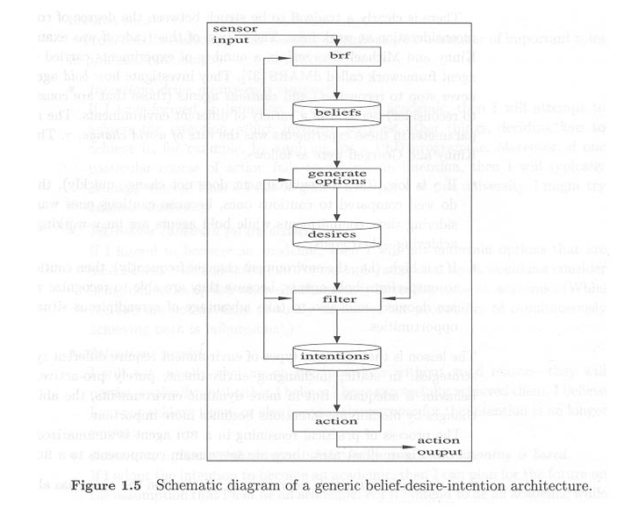
BDI Architecture

Slide 5
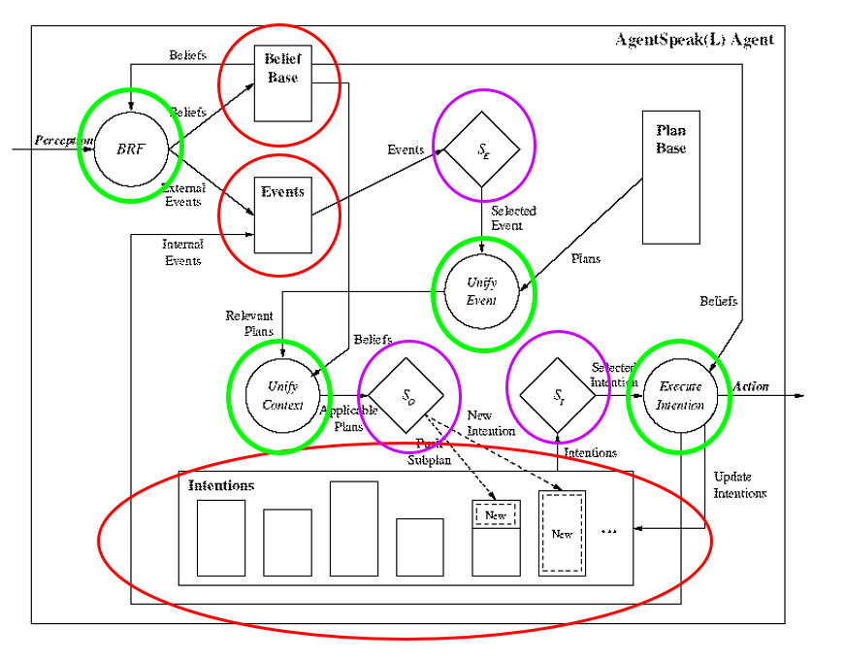
AgentSpeak
Abstract framework for Agent-oriented programming
Bridge the gap between theory and practice

Slide 6
Design
Three roles:
Goalie
Defender
Attacker
Formation: 1-2-2
1 Goalie, 2 Defenders, and 2 Attackers

Slide 7
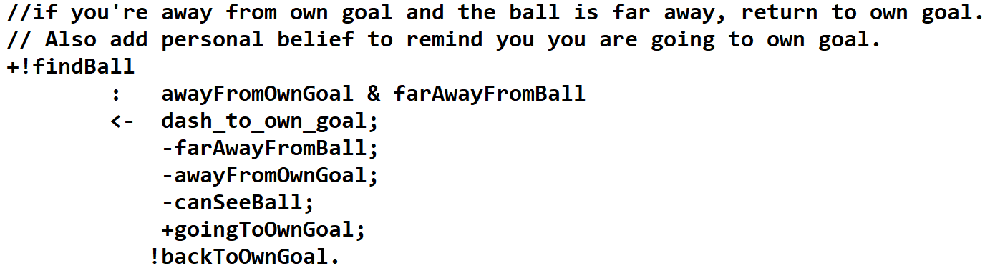
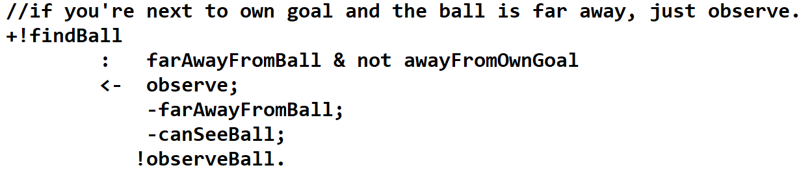
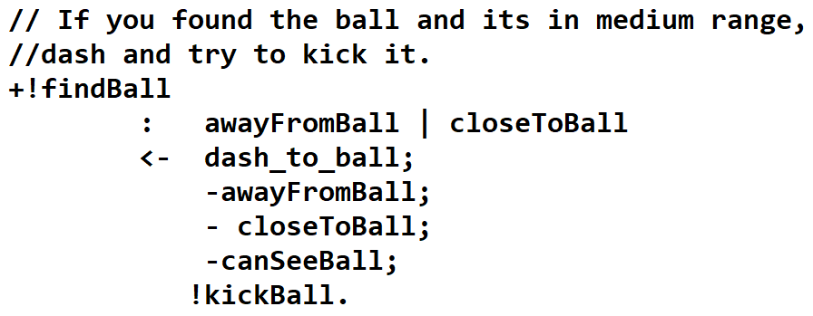
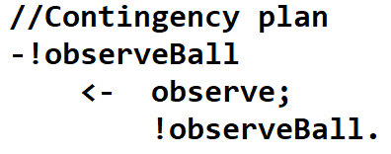
Goalie

Slide 8
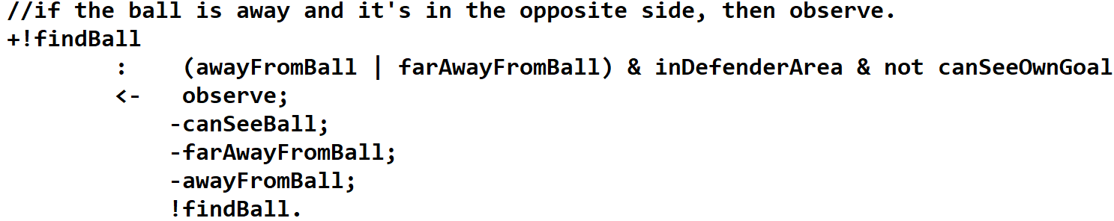
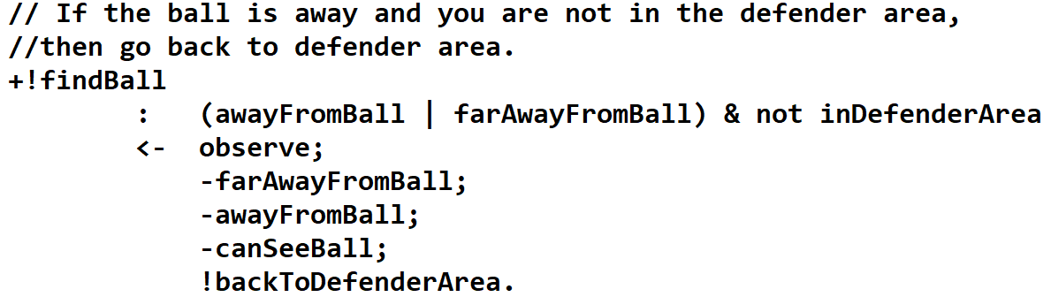
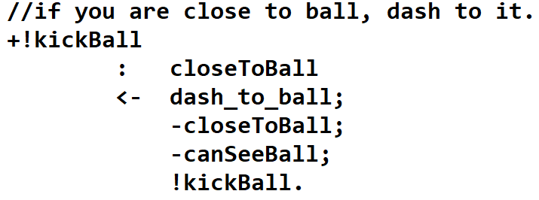
Defender

Slide 9
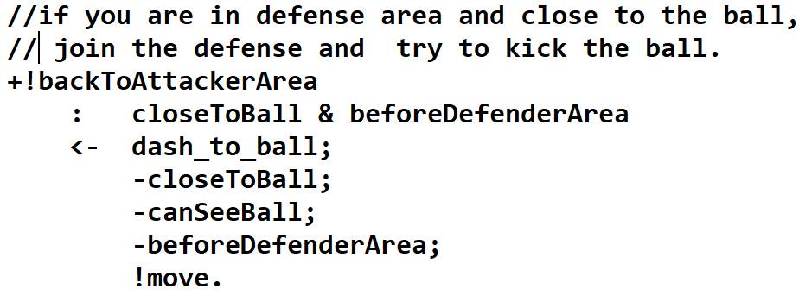
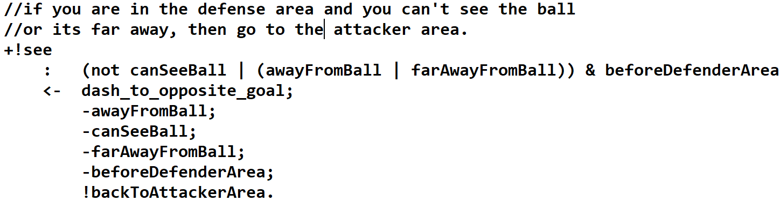
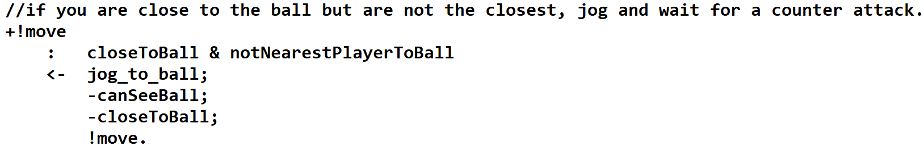
Attacker

Slide 10
THANKS!
Questions?

